Slide 1
Spatial Patterns, Correlations, and Predictive Modelling of Air Pollutants Across the United States
Group 30
Shivani Korupoju (11641995)
Nikhitha Vuppalapati (11645405)
Nikhil Kavali (11631192)

Slide 2
Agenda
Introduction
Research Objectives
Importance of Studying Air pollution
Data Collection, Preprocessing, and steps
Visualization of AQI Values
Spatial Patterns of Air Pollutants
Correlation Analysis
Evaluation
Predictive Modeling
Results
Limitations of Study
Conclusion
References

Slide 3

Introduction:
Air pollutants are an essential environmental hassle with awesome implications for human fitness, ecosystems, and the economic system.
It is a result of a complex aggregate of pollutants emitted from numerous assets, along with commercial centers, transportation, agriculture, and domestic activities.
The damaging results of air pollutants on public fitness have been nicely documented, with studies linking it to respiratory illnesses, cardiovascular problems, and even untimely mortality.

Slide 4

Research Objectives:
To find out how air pollutants is inside the United States as a whole
The first goal of this have a look at become to analyze the occurrence of air pollution, together with particulate remember (PM2.5 and PM10), ozone (O3), nitrogen dioxide (NO2), sulphur dioxide (SO2), carbon monoxide (CO), and Unstable natural compounds (VOCs)
To analyze the connection between air pollutants
The second goal is to analyze the relationship between numerous air pollution inclusive of PM2.Five, NO2 and O3.
To broaden fashions for predicting air first-class
The 0.33 objective is to increase fashions that expect air first-class the usage of spatio-temporal variability, meteorological statistics, and land use characteristics Using predictive modelling techniques including machine learning and regression records to expect destiny pollution levels.

Slide 5

Importance of studying Air pollution:
Public Health Effects: Air pollutants has giant public health implications, contributing to a wide range of respiratory and cardiovascular diseases.
Environmental Impact: Air pollution poses serious environmental demanding situations.
Economic Implications: The economic fees of air pollutants are widespread, affecting productivity, healthcare charges, and wonderful lifestyles.
Social Justice and Equity: Air pollution disproportionately affects marginalized groups and low-profits populations, exacerbating gift social inequalities.
Policy and Regulatory Implications: Research on air pollutants resources, emissions, and influences offers the clinical foundation for growing air exceptional standards, emission controls, and pollutants abatement strategies.

Slide 6
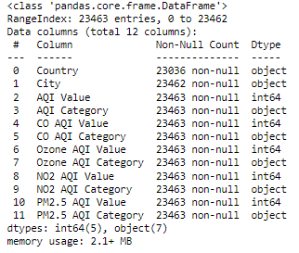
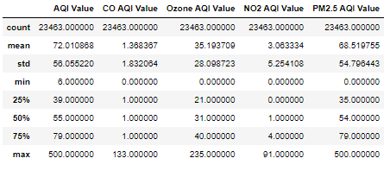
Data Collection and Preprocessing:
Data Preprocessing : Bellow is the descriptive data information.

Slide 7
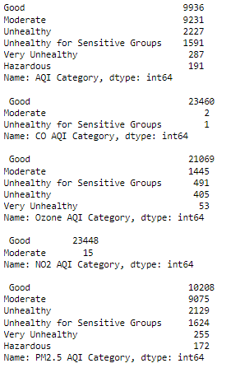
Data Collection and Preprocessing:
Data from regional air quality tracking networks, together with the ones operated via the Environmental Protection Agency (EPA) and kingdom environmental corporations, provide special measurements of pollutant concentrations at tracking stations throughout America. These datasets encompass facts on pollutants together with PM2.Five, PM10, NO2, SO2, CO, and O3, collected at normal durations the use of standardized monitoring protocols (Yanosky et al., 2014).

Slide 8

Data Cleaning and Preprocessing Steps:
Data cleaning and preprocessing are vital steps to ensure the remarkable reliability of the data used for analysis. The following steps are generally involved in information cleaning and preprocessing:
1.Quality Control: The first step involves assessing the outstanding of the information to perceive and deal with any errors, inconsistencies, or missing values.
2. Data Integration: Once the information from wonderful resources are amassed, they'll be incorporated right right into a unified dataset for assessment.
3. Data Transformation: Data transformation techniques may be accomplished to normalize the information, accurate skewness, or rework variables to meet the assumptions of statistical analysis techniques.
4.Spatial and Temporal Aggregation: Spatial and temporal aggregation can be executed to combination records at special spatial scales (eg., county-degree, state-degree) or temporal resolutions to facilitate analysis and visualization.

Slide 9
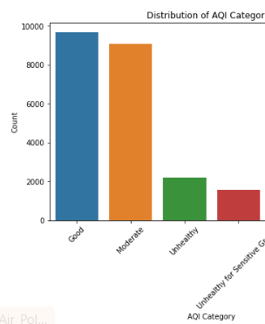
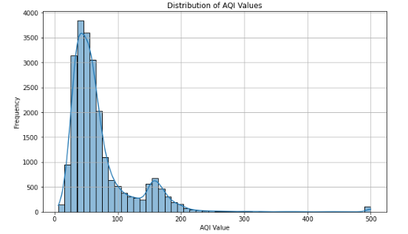
Visualization of AQI Values

Slide 10
Spatial Patterns of Air Pollutants:
Understanding the spatial varieties of air pollutants is important for identifying pollutants hotspots, assessing publicity risks, and enforcing focused mitigation strategies
Mapping Air Pollutant Concentrations Across the USA:
Mapping air pollutant concentrations in the United States involves visualizing the spatial distribution of pollutants using geographic information gadget (GIS) techniques.
Geographic maps are created to depict pollutant concentrations at monitoring stations and interpolate values to estimate concentrations at unmonitored places the usage of spatial interpolation strategies including kriging or inverse distance weighting.

Slide 11
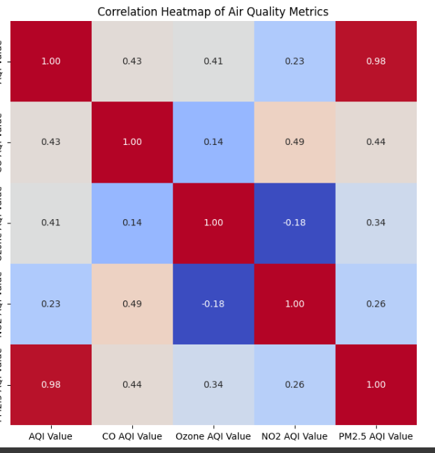
Correlation Analysis:
Correlation evaluation is crucial for understanding within the relationships among exclusive air pollution and identifying their institutions with demographic, commercial, and environmental elements. In this section, we will delve into the analysis of relationships amongst air pollutants and their correlations with various factors.
Analysis of Relationships Between Air Pollutants:
Analyzing the relationships amongst air pollution consists of calculating correlation coefficients to quantify the strength and path of associations among one among a kind pollutants. Pearson correlation coefficients or Spearman rank correlation coefficients are usually used to evaluate the degree of linear or monotonic relationships amongst pollutant concentrations at diverse location. Multiple regression evaluation may be hired to discover have an effect on of multiple predictors, inclusive of meteorological variables, emission assets, and land use characteristics, on pollutant concentrations.

Slide 12
Correlation with Demographic, Industrial, and Environmental Factors:
Correlating air pollutant concentrations with demographic, commercial enterprise, and environmental factors offers precious insights into the drivers of air pollution and its spatial distribution.
Demographic factors which includes populace density, urbanization, and socioeconomic reputation might also have an impact on pollutant emissions and exposure patterns, affecting air high-quality disparities across precise businesses.
Industrial sports, inclusive of producing, transportation, and electricity manufacturing, are giant belongings of air pollution and may correlate with accelerated pollutant tiers in close by areas.
Identifying commercial emissions hotspots and their associations with pollutant concentrations is essential for implementing targeted pollutants, dealing with measures and mitigating environmental consequences.

Slide 13
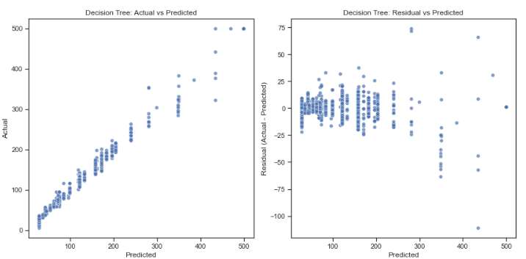
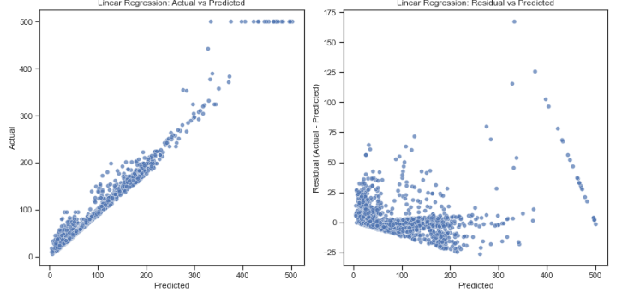
Evaluation:

Slide 14
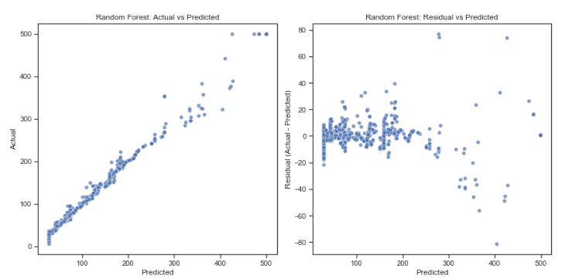
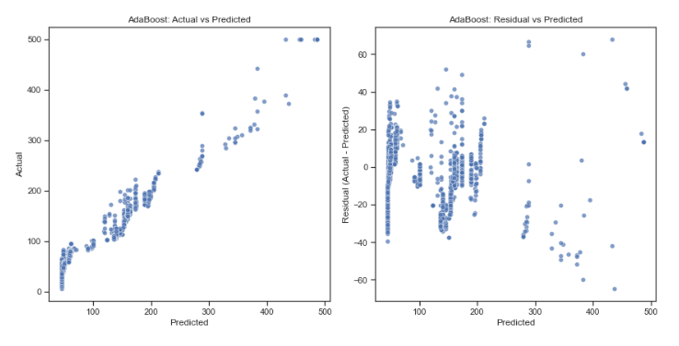
Evaluation:

Slide 15

Predictive Modeling:
Predictive modeling plays an essential position in forecasting air first-rate developments, assessing the effectiveness of pollutants, coping with measures, and informing selection-making strategies. In this segment, we can provide an overview of the predictive modeling framework, communicate model preference and validation strategies, and find out the improvement of predictive fashions for air satisfactory
Overview of Predictive Modeling Framework:
The predictive modeling framework includes several key steps, together with information preprocessing, version selection, training, validation, and assessment.
Initially, the dataset is wiped clean, pre-processed, and organized for analysis to ensure statistics great and integrity.

Slide 16
Linear Regression: Mean Squared Error: 85.15
R-squared Score: 0.97 Interpretation: This model explains the variance in the data. While it provides some insight into the relationship between predictors and the target variable, its explanatory power is limited compared to other models. Random Forest Regression: Mean Squared Error: 25.02
R-squared Score: 0.99 Interpretation: With an R-squared value of 0.99, the random forest regression model outperforms linear regression significantly. It captures 99% of the variance in the data, indicating a strong explanatory capability. Decision Tree:
Mean Squared Error (MSE): 39.55
R-squared Score: 0.99
The Decision Tree model has a very low mean squared error of 39.55, indicating that, on average, the squared differences between the actual and predicted values are quite small. Additionally, the R-squared score of 0.99 suggests that the model explains 99% of the variance in the target variable, indicating an excellent fit to the data.
AdaBoost:
Mean Squared Error (MSE): 159.65
R-squared Score: 0.95
The AdaBoost model has a higher mean squared error compared to the Decision Tree model, indicating that, on average, the squared differences between the actual and predicted values are larger. However, the R-squared score of 0.95 still indicates that the model explains 95% of the variance in the target variable, suggesting a good overall fit to the data.

Slide 17
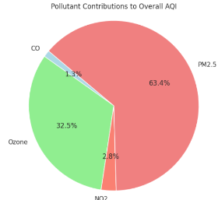
Results:
The consequences segment gives the findings obtained from spatial evaluation, correlation evaluation, and the performance metrics of predictive fashions. These findings provide insights into the spatial distribution of air pollution, the relationships among pollution and different factors, and the accuracy of predictive models for air remarkable evaluation.

Slide 18
Limitations of the Study:
Despite the treasured insights won from this look at, several barriers must be recounted. Firstly, the accuracy of predictive fashions may be affected by uncertainties in input records, model assumptions, and parameter estimation. Additionally, the spatial and temporal decision of available data may additionally restriction the granularity of analysis and the ability to capture localized variations in air pleasant.
The have a look at focused mostly on pollutant concentrations and did not do not forget other elements which include health results, publicity pathways, and social determinants of health. Future studies have to explore those factors to provide a greater complete know-how of air pollutants impacts on public fitness and proper-being.

Slide 19

Conclusion:
The conclusion section offers a precis of the key findings from the look at, highlights its contributions to the sphere of air first-class research, and offers suggestions for action based at the findings.
Summary of Key Findings:
In summary, this examination investigated spatial patterns, correlations, and predictive modeling of air pollution across america. The analysis discovered good sized spatial variability in air pollutant concentrations, with hotspots recognized in urban and industrialized areas.
Contributions to the Field:
This observation makes several contributions to the sphere of air best research. Firstly, it complements our know-how of air pollutant dynamics with the aid of figuring out pollutant hotspots, exploring the drivers of air pollution, and forecasting pollutant concentrations using advanced modeling techniques

Slide 20
References:
Beelen, R., Hoek, G., Pebesma, E., Vienneau, D., De Hoogh, K., & Briggs, D. J. (2009). Mapping of background air pollution at a fine spatial scale across the European Union. Science of the total environment, 407(6), 1852-1867.
Crouse, D. L., Goldberg, M. S., & Ross, N. A. (2009). A prediction-based approach to modeling temporal and spatial variability of traffic-related air pollution in Montreal, Canada. Atmospheric environment, 43(32), 5075-5084.
Greco, S. L., Wilson, A. M., Spengler, J. D., & Levy, J. I. (2007). Spatial patterns of mobile source particulate matter emissions-to-exposure relationships across the United States. Atmospheric Environment, 41(5), 1011-1025.
Hart, J. E., Yanosky, J. D., Puett, R. C., Ryan, L., Dockery, D. W., Smith, T. J., ... & Laden, F. (2009). Spatial modeling of PM10 and NO2 in the continental United States, 1985–2000. Environmental health perspectives, 117(11), 1690-1696.
Ren, X., Mi, Z., & Georgopoulos, P. G. (2020). Comparison of Machine Learning and Land Use Regression for fine scale spatiotemporal estimation of ambient air pollution: Modeling ozone concentrations across the contiguous United States. Environment international, 142, 105827.
Wong, D. W., Yuan, L., & Perlin, S. A. (2004). Comparison of spatial interpolation methods for the estimation of air quality data. Journal of Exposure Science & Environmental Epidemiology, 14(5), 404-41
Yanosky, J. D., Paciorek, C. J., Laden, F., Hart, J. E., Puett, R. C., Liao, D., & Suh, H. H. (2014). Spatio-temporal modeling of particulate air pollution in the conterminous United States using geographic and meteorological predictors. Environmental Health, 13, 1-15.

Slide 21


Slide 22
Link to Video Presentation: https://1drv.ms/v/s!Agce5ZmJbDbMj2Mf2dCIbmKg1TI6?e=jpzpkH

